Slide 1
History 10: Practice with Infographics
Learning How to Interpret

Slide 2
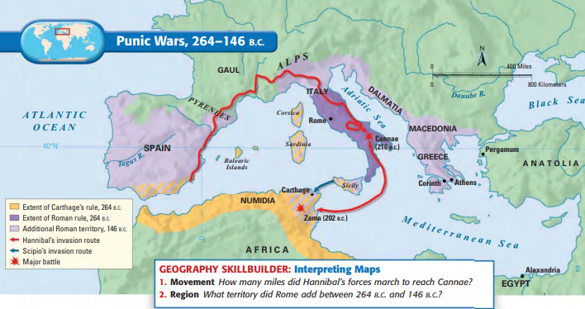
Geography

Slide 3
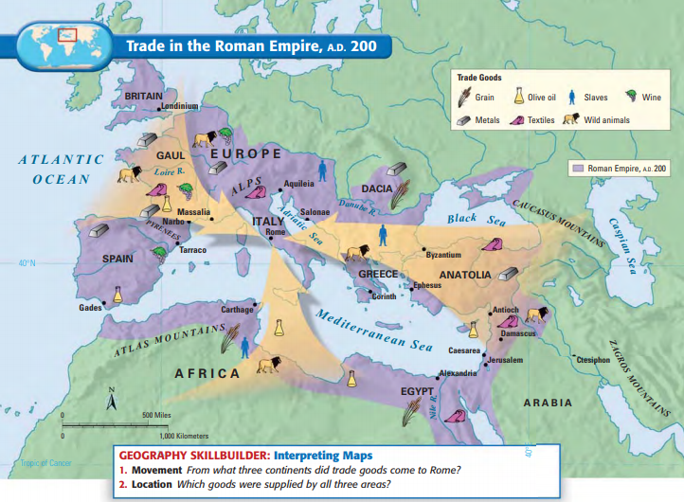
Trade

Slide 4
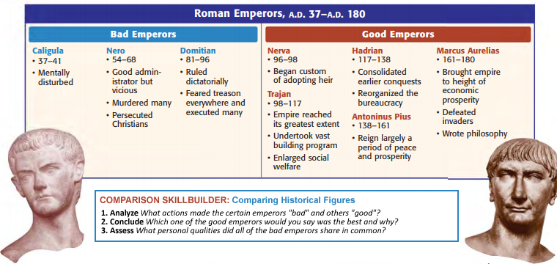
Comparisons

Slide 5
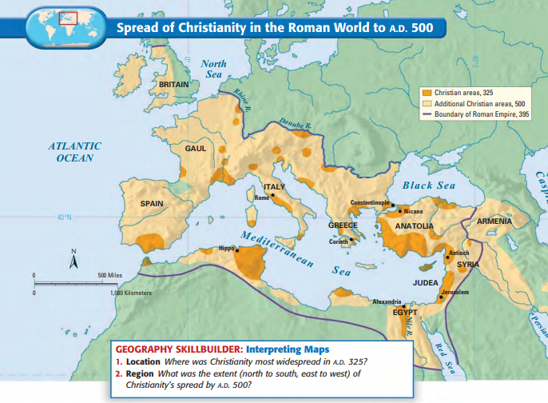
Interpreting Developments

Slide 6
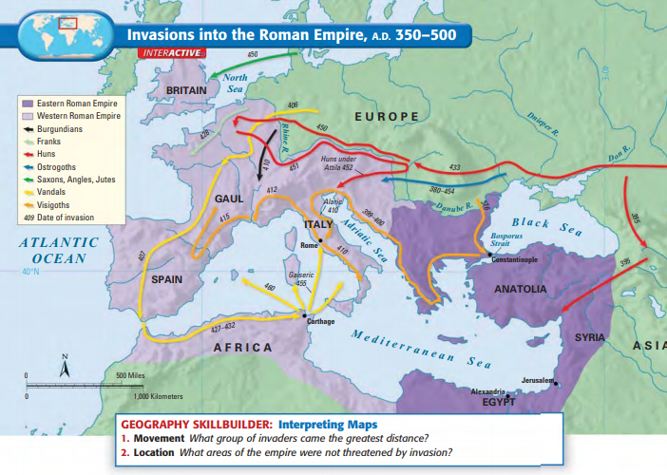
Interpreting Developments

Slide 7
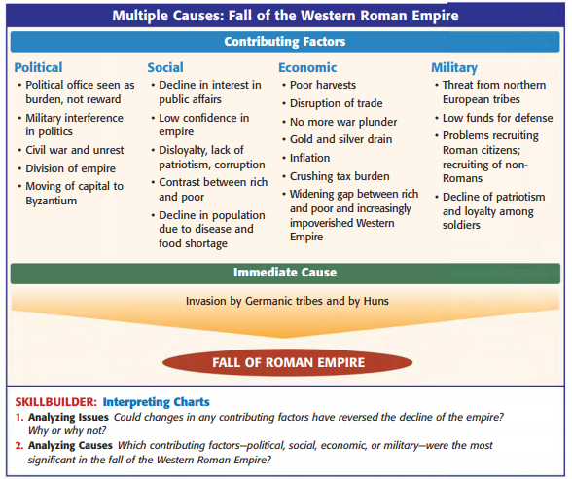
Causation

